Slide 1

EMERGENCY PROTOCOL
BY:-A.Vineelanjali (22N31A0511)
D.Rohith Sai (22N31A0545)
Pavan Aditya (22N31A0529)

Slide 2
INTRODUCTION…. 1.1PURPOSE AND OBJECTIVES
1.Emergency Preparedness: The website aims to promote emergency preparedness by providing accessible information on major health issues and their associated symptoms. 2.Rapid Identification: It serves as a tool for rapid identification of medical emergencies by offering clear, concise descriptions of symptoms associated with various health conditions. 3.Public Education: The project aims to educate the public about common medical emergencies, fostering a greater understanding of health issues and promoting proactive healthcare practices. 4.Resource Accessibility: Provides a centralized platform for accessing critical health information, enhancing accessibility for individuals seeking guidance during emergency situations. 5.Enhanced Safety: Ultimately, the website contributes to enhancing community safety by equipping individuals with the knowledge and resources necessary to respond effectively to medical emergencies.

Slide 3
OBJECTIVES
1.Information Accessibility: Ensure that information on major health issues and their symptoms is readily accessible to users, regardless of their location or device, to facilitate informed decision-making during emergencies. 2.User-Friendly Interface: Design a user-friendly interface that allows for easy navigation and quick access to relevant information, ensuring that users can find what they need efficiently during high-stress situations. 3.Content Accuracy: Maintain a high standard of accuracy and reliability in the information provided, collaborating with medical professionals to ensure that symptoms and recommended actions are up-to-date and medically sound. 4.Emergency Response Optimization: Contribute to optimizing emergency response efforts by empowering users with the knowledge to recognize symptoms early, thereby reducing response times and improving outcomes in medical emergencies. 5.Community Engagement: Foster community engagement by encouraging users to share their experiences, feedback, and suggestions for improving the website, creating a collaborative environment focused on continuously enhancing emergency preparedness and response.

Slide 4
1.2 EXISTING AND PROPOSED SYSTEM EXISTING:-
Assessment and Recognition: Identify the nature and severity of the emergency. This could involve assessing injuries, determining the cause of the emergency, and evaluating potential risks.
Notification: Alert relevant personnel, authorities, or emergency services about the situation. This may include contacting emergency services, notifying management, or activating an emergency alarm system.
Evacuation or Shelter-in-Place: Depending on the type of emergency, evacuate the affected area or instruct individuals to seek shelter indoors. Evacuation routes and assembly points should be clearly marked and communicated.
Communication: Maintain clear and consistent communication with all stakeholders, providing updates on the situation, instructions, and any necessary information.
Response and Mitigation: Take immediate actions to mitigate the effects of the emergency. This could involve administering first aid, containing a fire, controlling a hazardous spill, or implementing security measures.

Slide 5
6.Resource Allocation: Allocate resources such as personnel, equipment, and supplies as needed to address the emergency effectively.
7.Documentation and Reporting: Document all actions taken during the emergency, including any injuries, damages, or significant events. Reporting ensures that lessons can be learned and improvements can be made for future emergencies.
8.Recovery and Follow-Up: Once the immediate threat has been addressed, initiate recovery efforts to restore normal operations. This may involve cleanup, repairs, debriefing sessions, and follow-up assessments to identify areas for improvement.
9.Review and Update: Regularly review and update emergency protocols based on lessons learned from drills, exercises, and real-life emergencies. Continuously improving protocols helps ensure readiness for future emergencies.

Slide 6
PROPOSED:-
1.Centralized Information Hub: The proposed system aims to create a centralized hub for information on major health issues and their associated symptoms, providing users with a comprehensive resource for emergency preparedness. 2.User-Centric Design: It prioritizes user experience by employing a user-centric design approach, ensuring that the website is intuitive, easy to navigate, and accessible across various devices for seamless access to critical information during emergencies. 3.Dynamic Content Management: The system will implement dynamic content management practices to ensure that information remains up-to-date and accurate, with regular updates based on the latest medical research and guidelines. 4.Interactive Features: Incorporating interactive features such as symptom checkers, first-aid guides, and emergency contact directories enhances user engagement and facilitates better decision-making during medical emergencies. 5.Multi-Modal Accessibility: The proposed system will prioritize accessibility by incorporating multi-modal features such as text-to-speech, language translation, and compatibility with assistive technologies to cater to users with diverse needs and preferences. 6.Community Engagement Tools: It will include community engagement tools such as forums, feedback forms, and social media integration to encourage user participation, foster a sense of community, and facilitate knowledge sharing and collaboration.

Slide 7
1.3 SCOPE OF PROJECT
1.Content Development: Creating comprehensive and accurate content covering major health issues, symptoms, and recommended actions during emergencies. 2.Website Development: Designing and developing a user-friendly website with intuitive navigation, interactive features, and multi-modal accessibility. 3.Content Management: Implementing dynamic content management practices to ensure timely updates and accuracy of information. 4.Community Engagement: Facilitating user engagement through forums, feedback mechanisms, and social media integration to foster a collaborative environment. 5.Integration with Emergency Response Systems: Collaborating with emergency response systems and healthcare providers to integrate the website with existing infrastructure for streamlined communication and coordinated responses.

Slide 8
6.Testing and Quality Assurance: Conducting rigorous testing and quality assurance procedures to ensure the functionality, performance, and security of the website 7.Launch and Deployment: Deploying the website to production environments and managing its ongoing operation, maintenance, and support. 8.Scalability and Future Enhancements: Planning for scalability and future enhancements to accommodate growth, evolving healthcare needs, and technological advancements. effectively utilize the website and maximize its benefits in emergency situations.

Slide 9
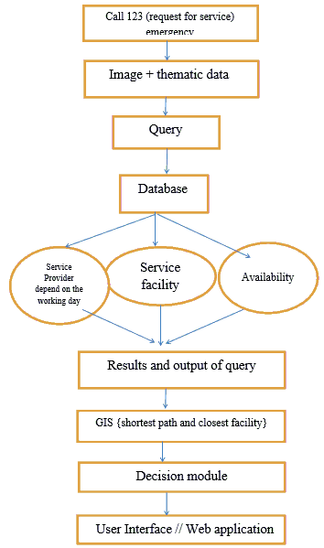
DESGIN

Slide 10
SOFTWARE REQUIREMENTS
1.Content Management System (CMS): Implement a robust CMS to manage and update content efficiently, allowing contributors to add, edit, and publish information about health issues, symptoms, and emergency protocols. 2.Web Development Framework: Utilize a modern web development framework such as Django, Ruby on Rails, or Laravel to build a scalable and maintainable web application with a solid foundation. 3.Database Management System (DBMS): Choose a reliable DBMS like PostgreSQL, MySQL, or SQLite to store website content, user data, and other relevant information securely. 4.Version Control System: Use a version control system such as Git to manage changes to the website’s source code, enabling collaboration among developers and ensuring code integrity. 5.Security Measures: Implement security measures such as HTTPS encryption, input validation, and user authentication to protect user data and prevent unauthorized access to sensitive information.

Slide 11
6.Responsive Design: Ensure that the website is responsive and mobile-friendly, providing a seamless user experience across various devices and screen sizes. 7.Accessibility Compliance: Adhere to accessibility standards such as WCAG (Web Content Accessibility Guidelines) to make the website accessible to users with disabilities, including features like alt text for images and keyboard navigation. 8.Search Functionality: Incorporate a robust search functionality to allow users to quickly find relevant information based on keywords, symptoms, or health condition. 9.Documentation and Support: Provide comprehensive documentation and user support resources to help contributors understand the project structure, coding standards, and how to contribute effectively to the open-source communication

Slide 12
HARDWARE REQUIREMENTS
1.Web Server: You’ll need a web server to host your website and serve web pages to users. Common choices include Apache, Nginx, or Microsoft Internet Information Services (IIS). 2.Server Hardware: The hardware specifications for your server will depend on factors such as expected traffic volume, the complexity of your website, and any additional services or applications running on the server. Generally, you’ll need sufficient CPU, RAM, and storage resources to handle incoming requests and serve content efficiently. 3.Storage: Allocate enough storage space to store website files, database backups, and any other data associated with your website. Consider using solid-state drives (SSDs) for improved performance and reliability. 4.Backup System: Implement a backup system to regularly back up your website files and database to prevent data loss in case of hardware failures, software errors, or security breaches. You may need additional storage space for storing backups. 5.Networking Equipment: Ensure that you have reliable networking equipment such as routers, switches, and firewalls to establish and maintain network connectivity for your server. Consider factors such as bandwidth, latency, and network security requirements.

Slide 13
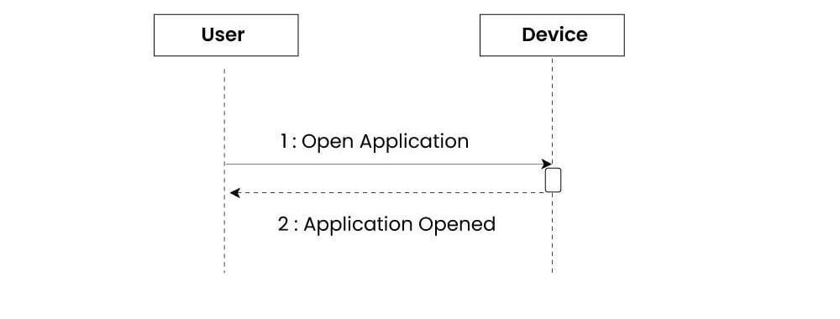
Sequence Diagram:-

Slide 14
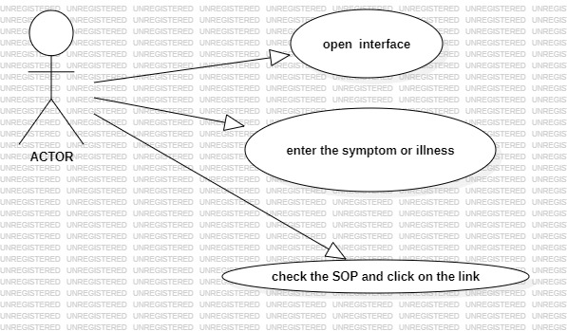
Usecase diagram:-

Slide 15
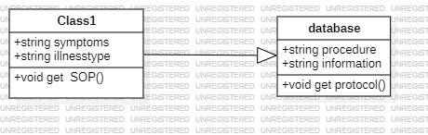
Class diagram:-

Slide 16
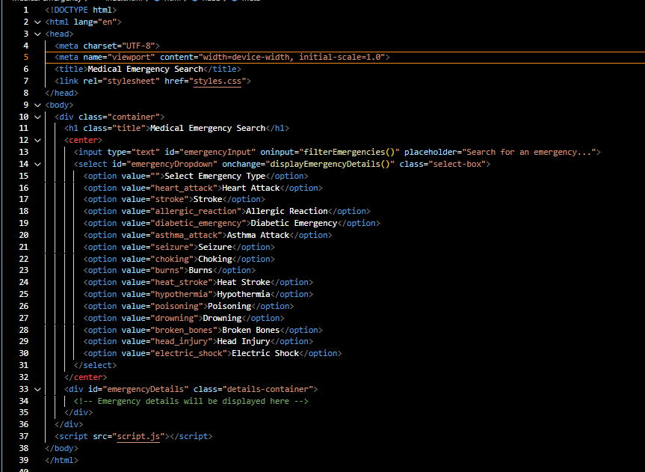
HTML CODE:-

Slide 17
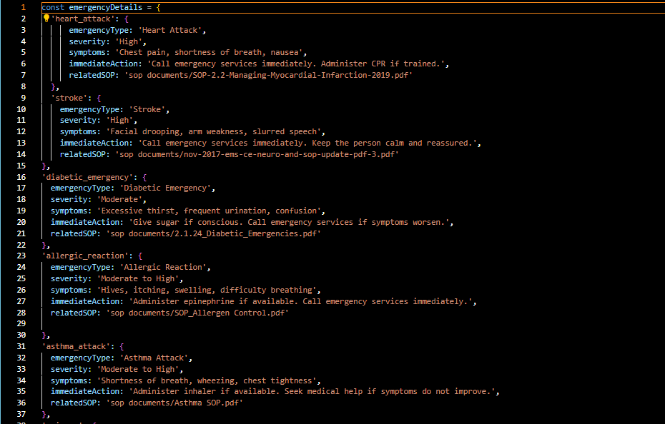
JAVA SCRIPT:-

Slide 18
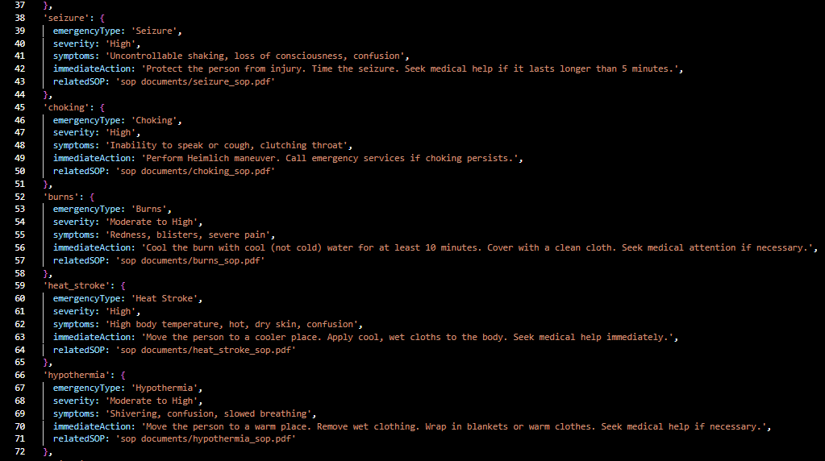

Slide 19
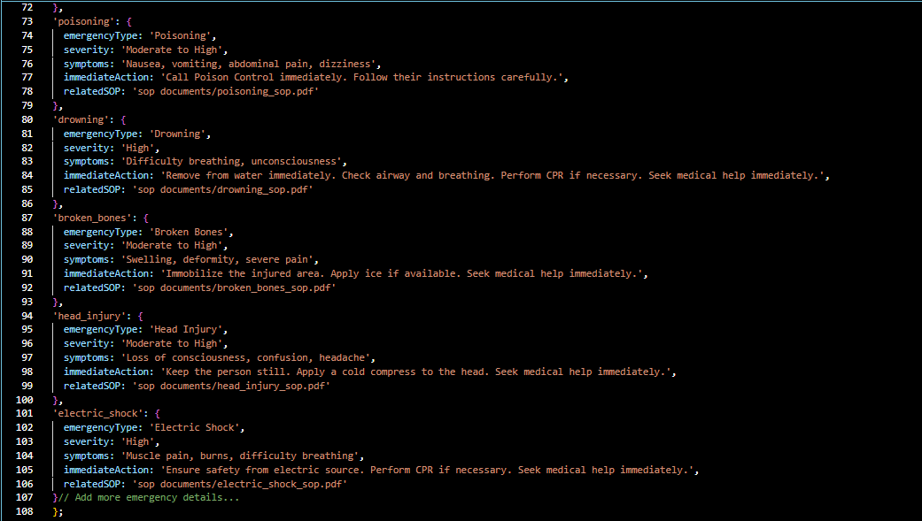

Slide 20
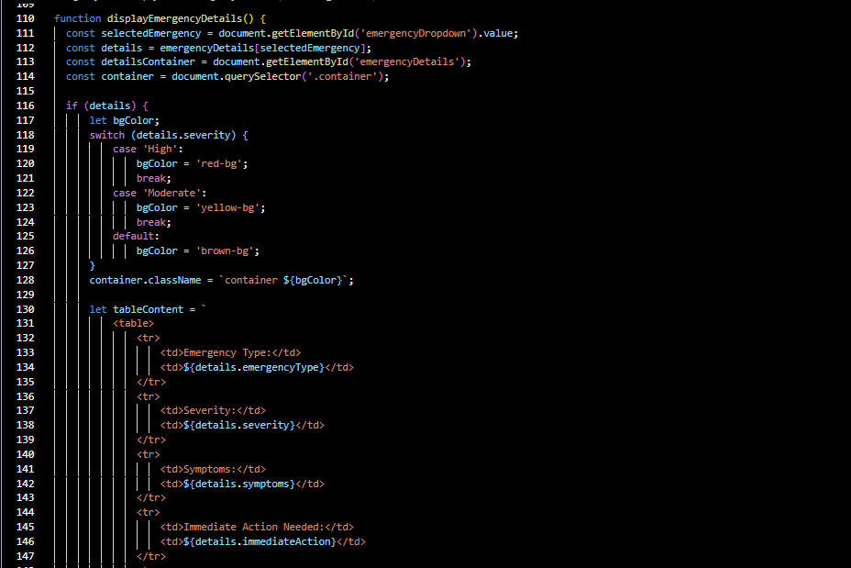

Slide 21
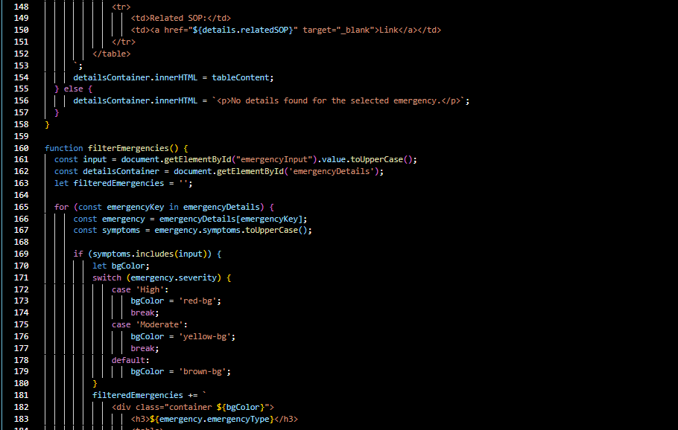
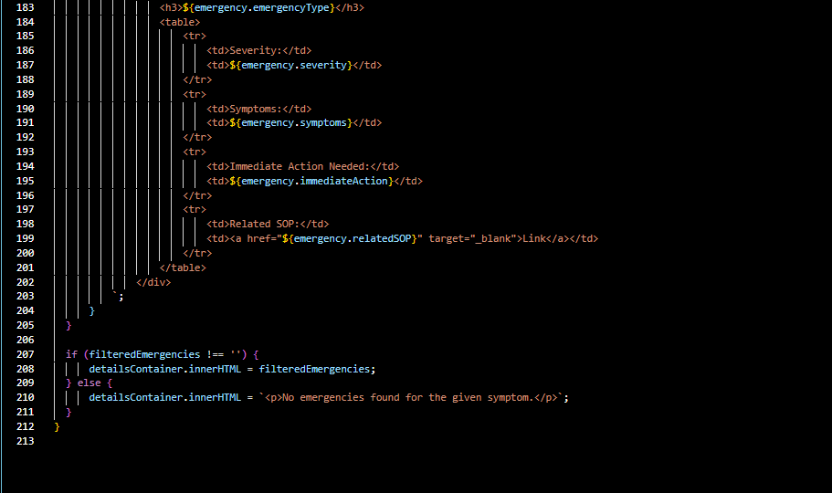

Slide 22
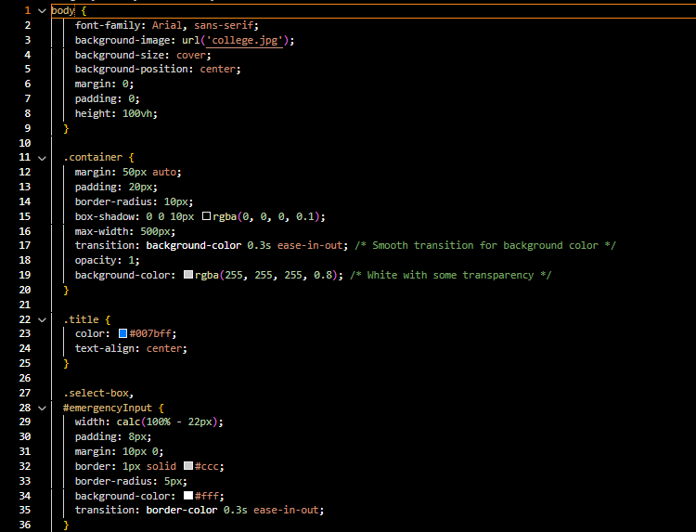
CSS :-

Slide 23
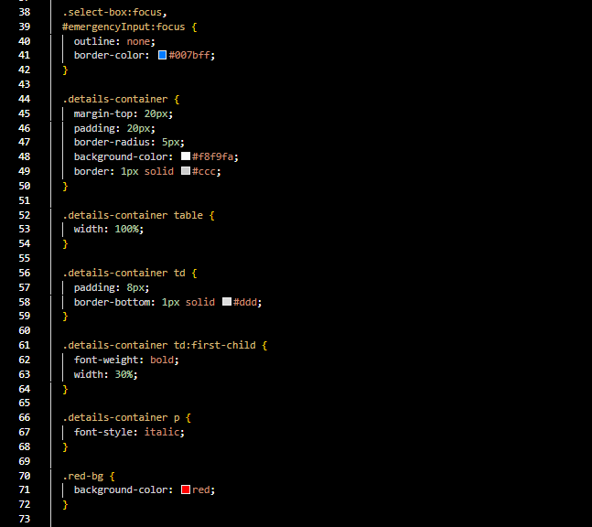


Slide 24
THANK YOU

